Slide 1
Measuring uncertainty beyond “Bootstrap”
Sarah MacDonnell, LCP
Pravesh Ponna, LCP
Tim Jordan, MPS
Jinnan Tang, Insight Risk Consulting

Slide 2

Beyond “Bootstrap”
Definition of “Bootstrap” - triangle techniques based on chain ladder, such as Mack or ODP bootstrap
A limited measure
The past is not necessarily a good guide to the future

Slide 3

Beyond “Bootstrap”
Is it realistic to define a distribution of outcomes at all?

Slide 4

Developing a framework

Slide 5
Measuring uncertainty beyond “Bootstrap”
Lessons from around the world
Data uncertainty
Expert judgement
Effectiveness of methods
Reserve risk appetite
Framework elements
Ireland
Australia
Chaucer

Slide 6

Ireland
Guidance on best estimate and margin for uncertainty

Slide 7
Guidance on margin for uncertainty
“Stress and scenarios testing are key techniques…. Where appropriate, statistical methods … should also be employed.”
Changes in claims environment – past and future
Exposures to latent claims or new types of claim
Exposure to binary events
Data quality issues
Mergers and acquisitions
Changes in claim handling

Slide 8
Guidance on margin for uncertainty
“The board should enumerate the constituents of the Margin for Uncertainty.”
Statistical buffer over best estimate
Impact of various scenarios and stresses considered
Allowance for diversification effects
Consideration of the Board’s risk Appetite Statement

Slide 9
Measuring uncertainty beyond “Bootstrap”
Lessons from around the world
Data uncertainty
Expert judgement
Effectiveness of methods
Reserve risk appetite
Framework elements
Ireland
Australia

Slide 10
Risk Margin Requirement in Australia
Some history
Historically
2002
2008
  Implicit risk margins by adopting conservative assumptions, but no accounting requirement
  Explicit risk margin requirement
  Actuaries Institute’s new framework for assessing risk margins
Insurance liability provision to include a risk margin that is at least the greater of:
  A value which provides an insurance liability provision with a 75% probability of sufficiency; and
  One-half of a standard deviation above the mean.

Slide 11
Determining risk margins – ‘Bolt-on’ approach
Determine mean estimate and risk margin separately
Determine coefficient of variation (CoV)
Apply dependency structure across class of business
Assume a distribution
Risk margin at 75% (and test against half the CoV)

Slide 12
Sources of uncertainty
What could cause the valuation estimate to be wrong?
Independent risk (random/process error)
Internal systemic risk (parameter & model error)
External systemic risk
Inherent volatility associated with the insurance process
Randomness compromising the ability to select correct parameters
Uncertainty arising from the model being an imperfect representation of real life
Uncertainty arising from future systemic trends external to the modelling process (eg economic, legal, natural peril events etc)

Slide 13
Sources of uncertainty
Internal systemic risk – how wrong could the actuary get it?
Independent risk (random/process error)
Internal systemic risk (parameter & model error)
External systemic risk
Inherent volatility associated with the insurance process
Randomness compromising the ability to select correct parameters
Uncertainty arising from the model being an imperfect representation of real life
Uncertainty arising from future systemic trends external to the modelling process (eg economic, legal, natural peril events etc)

Slide 14
‘New’ Framework
Internal systemic risk – how wrong could the actuary get it?
1. Qualitative assessment of risk indicators
2. Score and weight risk indicators
3. Calibrate to CoV
Specification (model) error
Models used
Subjective adjustments
Parameter selection error
Ability to detect trends, stability
Uncertainty in superimposed inflation
Data error
Timeliness and reliability
Revisions to past data
Qualitative ‘balanced scorecard’ approach
Rank aspects of the modelling from worst to best practice
Convert score to quantitative measure by using CoV mapping scale
Significant amount of judgement

Slide 15
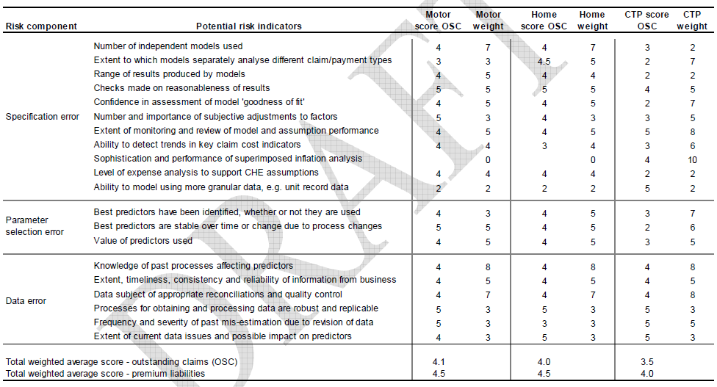
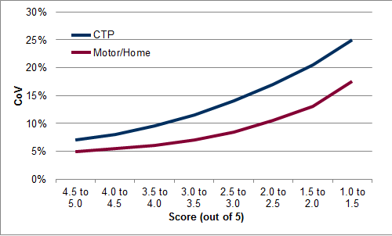
‘New’ Framework
Internal systemic risk – how wrong could the actuary get it?
High Risk
Low Risk
1
5
Source: ‘A Framework for Assessing Risk Margins’, Prepared by the Risk Margins Taskforce
http://www.actuaries.asn.au/Library/Framework%20for%20assessing%20risk%20margins.pdf

Slide 16
Sources of uncertainty
External systemic risk – non random risks outside the modelling process
Independent risk (random/process error)
Internal systemic risk (parameter & model error)
External systemic risk
Inherent volatility associated with the insurance process
Randomness compromising the ability to select correct parameters
Uncertainty arising from the model being an imperfect representation of real life
Uncertainty arising from future systemic trends external to the modelling process (eg economic, legal, natural peril events etc)

Slide 17






‘New’ Framework
External systemic risk – non random risks outside the modelling process
Economic and social risks
Legislative, political and claims inflation risk
Claim management process change risk
Event risk
Latent claim risk
Recovery risk

Slide 18
Measuring uncertainty beyond “Bootstrap”
Data uncertainty
Expert judgement
Effectiveness of methods
Reserve risk appetite
Framework elements

Slide 19
Data uncertainty – matrix
Data problems we often hear…
One example of data uncertainty matrix currently in use:
A more detailed measure? As the level of data quality can be an aggregate effect of many other factors: location, measurability, nature, quantity and judgements.
We’ve had a big change in our claims handling process
We just have the bordereaux available for that class
We had a few missing case estimates at year-end
The only triangle we have is net paid
Data Uncertainty by reserving class (count) |  | Data quality
 |  | Poor | Below average | Average | Above average | Excellent | Total
Materiality (Reserve £m) | Low (<£5m) | 2 |  | 2 | 7 |  | 11
 | Mid (£5m to £25m) | 1 |  |  | 3 | 2 | 6
 | High (£25m+) |  |  | 3 | 12 |  | 15
 | Total | 3 | 0 | 5 | 22 | 2 | 32
By class (number)

Slide 20
Data uncertainty – additional dimensions
Locating potential data uncertainty as a first step towards a finer measurement, the table below should provide a clearer path.
Stages | Data uncertainty sources
 | Operation | System | Real world | Expert judgement
Target and obtain | Negligence in planning. Missing out certain classes | New classes falling outside system scope. | Little data with new business. Evolving risk changing target scope. | Not seeing the complete picture.
Store and share | Inconsistent formats with claims input. Loose definition and labelling. | Lack of storage capacity. Lack of security control on access. | Underlying risk evolving ignored. | Having to choose which data should be stored.
Use | Incorrect data used. Error linking to model. | Poor data output functionality. | Model or method change. | Assumptions replacing data. Selection of data and amount to use.
Maintain | No documentation on claims data manipulation. | Inflexible for data adjustments. Claims record loss during system upgrade. | Evolving risk/model triggers unplanned development pattern adjustments | Overlook certain data areas, misjudging proportionality.
Dispose | Disposing incorrect policy records. | Lack of recovery functions. | Evolving risk may shorten data lifetime, accelerate disposure. | Premature disposure of historical claims.

Slide 21
Data uncertainty – matrix new view
The data uncertainty matrix below should help to generate a qualitative overview of where most important uncertainties are, and how these can be further measured in a number of uncertainty dimensions.
Data Uncertainty Matrix | Measurability of uncertainty (from determinism, through probability and possibility to ignorance) |  |  | Nature of Uncertainty |  | Qualification of knowledge base (backing) |  |  | Value-Ladenness of judgements
 | Statistical uncertainty | Scenario uncertainty | Recognised ignorance | Knowledge related | Variability related | Strong | Fair | Weak | Large | Medium | Small
Data issues by source
Source: RIVM/MNP Guidance for uncertainty assessment and communication, October 2003
Notes:
Significance of uncertainty:
Statistical: concerns uncertainties which can be adequately expressed in statistical terms, e.g. such as a range with associated probabilities, (examples: statistical expressions for data inaccuracies comparing to actual experience, expert judgements comparing to data that became available, uncertainties in data sampling…)
Scenario: uncertainties which cannot be depicted in terms of probabilities but can only be expressed in terms of possible outcomes.
Recognised: known unknowns, cannot establish any useful estimate. This is most likely to carry the highest level of uncertainty by nature.
Nature of uncertainty:
Knowledge related: data uncertainty due to incompleteness of knowledge or information, which can be reduced by more research and more relevant data, to the point where even if we had perfect data, we will still be left with some risk as data cannot fully replicate the real world which keeps generating new data: “parameter risk”.
Variability related: data uncertainty due to the intrinsic variability/randomness of the claims we are trying to model, can be reduced by improving model and data system but not more data itself, to the point where a perfect model is developed, and the modelled result is still almost certainly not going to be the actual result: “process risk”.
Qualification of knowledge base:
refers to quality and quantity of data, or the degree of underpinning, level of confidence we are about our uncertainty statements. We can look at data source for example, whether internal or external…
Value-ladenness of choice:
refers to subjectiveness of judgements made, data selected…more relevant to operations and expert judgement. If high, need to look at how sensitive the decisions or judgements are to changes in information available on which they are based. Also how material are the impacts of the decisions and judgements to the final result. This leads to the next slide on EJ…

Slide 22
Framework
Expert judgement
Effectiveness of methods
Reserve risk appetite
Data uncertainty

Slide 23
Expert judgement uncertainty – current practice
Challenges associated with uncertain data necessitate the use of expert judgement.
A recognised method of measuring expert judgement uncertainty is to look at its subjectivity against sensitivity.
Any other factors that would also impact the level of expert judgement uncertainty?
More risky
Subjectivity
Materiality
Less risky
Sensitivity
Assessing subjectivity- range of judgements
Assessing sensitivity – sensitivity of reserves to judgement changes
Determine materiality

Slide 24
Expert judgement uncertainty – other factors
Expert Judgement Uncertainty
Framework
Expertise
Elicitation
Culture
Sensitivity
Subjectivity
Quality of policy, governance, documentation, process, validation, system, data
Fresh, focus, know your limits, herd effects
Qualification, experience level of experts
Interview with experts, unbiased ,independent communication with user and decision makers
Plausible range
Impact of changing judgements on reserving results
Sources: Sitting in judgement – The Actuary, Nov 2013. Getting better judgment – Getting better judgement working party. Expert judgement – Solvency and capital management working party
Additional uncertainty which should not outweigh its benefit.
A point based approach? Similar to safety rating used for cars and airlines.
Notes:
Eg reserving guidance suggests scenario testing – make sure that appropriate experts are used to supply scenarios rather than being defined by the actuary

Slide 25
Communication - Language
GI ROC paper “Quantification and Reporting of Uncertainty for GI Reserving” 2007 suggested standard vocabulary for communicating reserve uncertainty
Weather scientists also use a similar approach - The Intergovernmental Panel on Climate Change
What’s the percentages for “fairly likely”, “likely” and “very likely” in your own interpretation?
Why do you think it is not used more?
Indicative percentile | 75% | 90 % | 95 % | 99%
Wording ‘below’ percentile | Fairly likely that the outcome will lie below this estimate | Likely that the outcome will lie below this estimate | Very likely that the outcome will lie below this estimate | Extremely likely that the outcome will lie below this estimate
Wording ‘above’ percentile | Reasonable chance that the outcome could lie above this estimate | Possible but unlikely that the outcome will lie above this estimate | Possible but very unlikely that the outcome will lie above this estimate | There is a possibility, albeit remote, that the outcome will lie above this estimate
Notes:
Comparing to more established frequency words: sometimes, often, usually, always...?

Slide 26
Framework
Expert judgement
Effectiveness of methods
Reserve risk appetite
Data uncertainty

Slide 27
Effectiveness of Methods
In selecting a best estimate for reserving it should recognised that a range of methods are available to achieve this
Looking at the outputs of a range of methods can help measure the model uncertainty (the risk that your chosen model is wrong)
The Effectiveness of Methods Working Party (2008/2009) listed the following methods and tested them for effectiveness
Possible Reserving Methods
Chain ladder (PCL, ICL)
Bornheutter-Ferguson (PBF, IBF)
ACPC-based methods (APC, AIC, PPCI, PPCF)
Case estimate-based methods (PCE)
Operational time (OpTime)
Probabilistic trend family (eg ICRFS)
Other (user-selected) methods…

Slide 28
Range of Methods
Use of an “overview grid” of results can help the Actuary understand the variation in the result based on choosing different methods
Where wildly different results are being obtained this can indicate your choice of model is important and there may be model risk which should be discussed
Model risk could also extend to choice of development factor exclusions and selection of tail factors
Outputs can also be shown as graphs in order to aid communication

Slide 29
Range of Methods

Slide 30
Framework
Expert judgement
Effectiveness of methods
Reserve risk appetite
Data uncertainty

Slide 31
Reserve Risk and ERM – qualitative aspects
Rating Agencies assess risks qualitatively as well as quantitatively
Benchmark reserve risk qualitatively?
Reserve Risk is also often considered as part of a risk appetite within
an ERM framework
Reserve Risk
Insurance Risk
Enterprise Risk

Slide 32
Risk Control Indicators
Reserve & Claims Management Control from rating agency perspective
Track record of consistent reserve releases
Independent centralised reserving function with effective feedback loops
Assumptions robustly set and justified
Information fed into economic capital models
Robust review process, including both internal and third party actuarial reviews
Well-defined and extensive claims management framework
Experienced chronic adverse development
Lack of adequate understanding and modelling of the risk of adverse loss development.
Reserving is fragmented in business units without centralized coordination or supervision
Reserving is disconnected from claims and might be pressured from underwriting
The review process is unsatisfactory and has failed to reveal chronic issues
There are no claims management authority levels or they’re not applied in practice.
Inspired by “S & P Insurance Enterprise Risk Management Criteria May 2013”

Slide 33
True or false?
“A well defined claims management framework should lead to less reserve uncertainty than a poorly defined claims management framework, as the risk of adverse deviation in reserves and/or claims payments for operational reasons should be reduced”
  “A disjointed actuarial function spread across many territories with no central oversight is more likely to lead to an out-turn that deviates from best estimate than an integrated actuarial function with central oversight”
  “A reserving function that obtains third-party review of its work is more likely to understand its reserves and risks and hence less likely to assess reserve uncertainty incorrectly”
  “A reserving team that does not perform stress and scenario testing is less able to understand its reserve risks than a team which does and is hence more likely to assess reserve uncertainty incorrectly”
Notes:
Almost the inverse of “Actuary in the box”

Slide 34
Reserve Risk within Risk Appetite
Deterioration of reserves is not to exceed b% in any one quarter
1-in-200 deviation not to exceed c% of gross income
“We have no appetite for significant deviations in earnings driven by reserving deficits”
Reserves/premiums ratios…. be greater than x%
Reserving Risk Capital Charge not be greater than x% of….
Capital at risk from potential claims reserving losses (based on the VaR for the whole reserve portfolio) should not exceed x% (e.g. 20%) of own funds according to SII calculation
Analysis of Company Reports to understand treatment of Reserve Risk

Slide 35

Measuring uncertainty
What next?
Do something about it!
MUQ Stage 2
Join the working party
Feedback your views
Have a chat with a colleague
See our website
  (find the GIROC page and follow your nose)
sarah.macdonnell@lcp.uk.com

Slide 36
Questions
Comments
The views expressed in this presentation are those of invited contributors and not necessarily those of the IFoA. The IFoA do not endorse any of the views stated, nor any claims or representations made in this presentation and accept no responsibility or liability to any person for loss or damage suffered as a consequence of their placing reliance upon any view, claim or representation made in this presentation.
The information and expressions of opinion contained in this publication are not intended to be a comprehensive study, nor to provide actuarial advice or advice of any nature and should not be treated as a substitute for specific advice concerning individual situations. On no account may any part of this presentation be reproduced without the written permission of the IFoA.

